Slide 1

Servlet

Slide 2
Servlet technology is used to create web application (resides at server side and generates dynamic web page).
Servlet technology is robust and scalable because of java language.
Before Servlet, CGI (Common Gateway Interface) scripting language was popular as a server-side programming language.

Slide 3
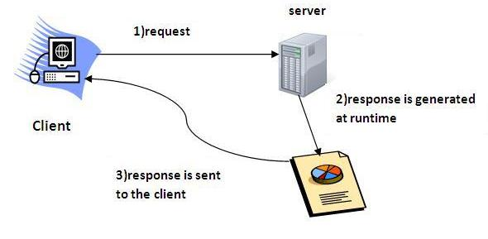
What is a Servlet?
Servlet can be described in many ways, depending on the context.
Servlet is a technology i.e. used to create web application.
Servlet is an API that provides many interfaces and classes including documentations.
Servlet is an interface that must be implemented for creating any servlet.
Servlet is a class that extend the capabilities of the servers and respond to the incoming request. It can respond to any type of requests.
Servlet is a web component that is deployed on the server to create dynamic web page.

Slide 4
What is web application?
A web application is an application accessible from the web.
A web application is composed of web components like Servlet, JSP, Filter etc. and other components such as HTML.
The web components typically execute in Web Server and respond to HTTP request.

Slide 5
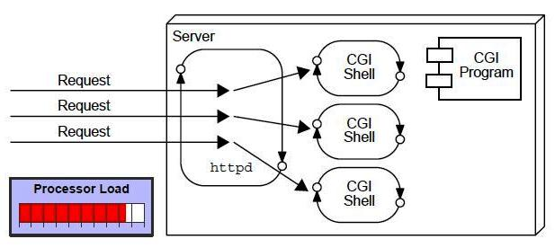
CGI(Common Gateway Interface)
CGI technology enables the web server to call an external program and pass HTTP request information to the external program to process the request.
For each request, it starts a new process.
Disadvantages of CGI
If number of clients increases,
it takes more time for sending response.
For each request, it starts a process
and Web server is limited to start processes.
It uses platform dependent language
e.g. C, C++, perl.

Slide 6
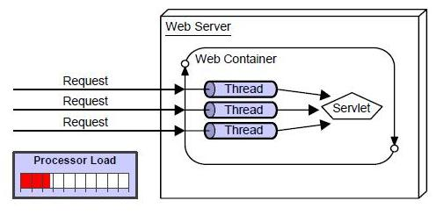
Advantage of Servlet
There are many advantages of servlet over CGI.
The web container creates threads for handling the multiple requests to the servlet.
Threads have a lot of benefits over the Processes such as they share a common memory area, lightweight, cost of communication between the threads are low.
Better performance: because it creates a thread for each request not process.
Portability: because it uses java language.
Robust: Servlets are managed by JVM so we don't need to worry about memory leak, garbage collection etc.
Secure: because it uses java language..

Slide 7
Servlet Terminology | Description
Website: static vs dynamic | It is a collection of related web pages that may contain text, images, audio and video.
HTTP | It is the data communication protocol used to establish communication between client and server.
HTTP Requests | It is the request send by the computer to a web server that contains all sorts of potentially interesting information.
Get vs Post | It give the difference between GET and POST request.
Container | It is used in java for dynamically generate the web pages on the server side.
Server: Web vs Application | It is used to manage the network resources and for running the program or software that provides services.
Content Type | It is HTTP header that provides the description about what are you sending to the browser.
Web Terminology

Slide 8
Servlet API
The javax.servlet and javax.servlet.http packages represent interfaces and classes for servlet api.
The javax.servlet package contains many interfaces and classes that are used by the servlet or web container. These are not specific to any protocol.
The javax.servlet.http package contains interfaces and classes that are responsible for http requests only.

Slide 9
Interfaces in javax.servlet package
Servlet
ServletRequest
ServletResponse
RequestDispatcher
ServletConfig
ServletContext
SingleThreadModel
Filter
FilterConfig
FilterChain
ServletRequestListener
ServletRequestAttributeListener
ServletContextListener
ServletContextAttributeListener

Slide 10
Classes in javax.servlet package
GenericServlet
ServletInputStream
ServletOutputStream
ServletRequestWrapper
ServletResponseWrapper
ServletRequestEvent
ServletContextEvent
ServletRequestAttributeEvent
ServletContextAttributeEvent
ServletException
UnavailableException

Slide 11
Interfaces in javax.servlet.http package
HttpServletRequest
HttpServletResponse
HttpSession
HttpSessionListener
HttpSessionAttributeListener
HttpSessionBindingListener
HttpSessionActivationListener
HttpSessionContext (deprecated now)

Slide 12
Classes in javax.servlet.http package
HttpServlet
Cookie
HttpServletRequestWrapper
HttpServletResponseWrapper
HttpSessionEvent
HttpSessionBindingEvent
HttpUtils (deprecated now)

Slide 13
Servlet Interface
Servlet interface provides common behaviour to all the servlets.
Servlet interface needs to be implemented for creating any servlet.
It provides 3 life cycle methods that are used to initialize the servlet, to service the requests, and to destroy the servlet and 2 non-life cycle methods.

Slide 14
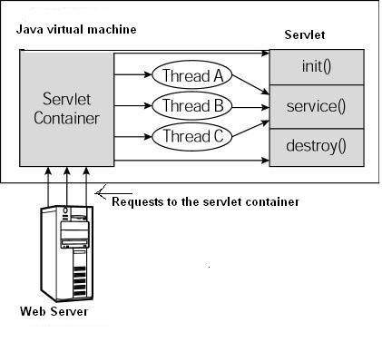
Servlets - Life Cycle
First the HTTP requests coming to the server are delegated to the servlet container.
The servlet container loads the servlet before invoking the service() method.
Then the servlet container handles multiple requests by producing multiple threads, each thread executing the service() method of a single instance of the servlet.

Slide 15

A servlet life cycle can be defined as the entire process from its creation till the destruction.
The servlet is initialized by calling the init () method.
The servlet calls service() method to process a client's request.
The servlet is terminated by calling the destroy() method.
Finally, servlet is garbage collected by the garbage collector of the JVM.

Slide 16
The init() method :
The init method is designed to be called only once.
It is called when the servlet is first created, and not called again for each user request.
So, it is used for one-time initializations, just as with the init method of applets.
The servlet is normally created when a user first invokes a URL corresponding to the servlet, but you can also specify that the servlet be loaded when the server is first started.
When a user invokes a servlet, a single instance of each servlet gets created, with each user request resulting in a new thread that is handed off to doGet or doPost as appropriate.
The init() method simply creates or loads some data that will be used throughout the life of the servlet.
Syntax
public void init() throws ServletException { // Initialization code... }

Slide 17
The service() method :
The service() method is the main method to perform the actual task.
The servlet container (i.e. web server) calls the service() method to handle requests coming from the client( browsers) and to write the formatted response back to the client.
Each time the server receives a request for a servlet, the server issues a new thread and calls service.
The service() method checks the HTTP request type (GET, POST, PUT, DELETE, etc.) and calls doGet, doPost, doPut, doDelete, etc. methods as appropriate.
Syntax:-
public void service(ServletRequest request, ServletResponse response) throws ServletException, IOException{ }

Slide 18
The doGet() Method
In doGet(), the parameters are appended to the URL and sent along with the header information.
doGet() shall be used when small amount of data and insensitive data like a query has to be sent as a request.
Syntax:
public void doGet(HttpServletRequest request,
HttpServletResponse response)
throws ServletException , IOException
{// Servlet code}

Slide 19
The doPost() Method
In doPost(), the parameters are sent separately.
doPost() shall be used when comparatively large amount of sensitive data has to be sent. Examples are sending data after filling up a form or sending login id and password.
Syntax:
public void doPost(HttpServletRequest request,
HttpServletResponse response)
throws ServletException , IOException
{// Servlet code}

Slide 20
The destroy() method :
The destroy() method is called only once at the end of the life cycle of a servlet.
This method gives your servlet a chance to close database connections, halt background threads, write cookie lists or hit counts to disk, and perform other such cleanup activities.
After the destroy() method is called, the servlet object is marked for garbage collection.
Syntax:
Public void destroy()
{ // Finalization code……}

Slide 21
Methods of Servlet interface
Method | Description
public void init(ServletConfig config) | initializes the servlet. It is the life cycle method of servlet and invoked by the web container only once.
public void service(ServletRequest request,ServletResponse response) | provides response for the incoming request. It is invoked at each request by the web container.
public void destroy() | is invoked only once and indicates that servlet is being destroyed.
public ServletConfig getServletConfig() | returns the object of ServletConfig.
public String getServletInfo() | returns information about servlet such as writer, copyright, version etc.

Slide 22
Steps to create a servlet example
The servlet example can be created by three ways:
The servlet example can be created by three ways:
By implementing Servlet interface,
By inheriting GenericServlet class, (or)
By inheriting HttpServlet class

Slide 23
GenericServlet class
GenericServlet class implements Servlet, ServletConfig and Serializable interfaces.
It provides the implementation of all the methods of these interfaces except the service method.
GenericServlet class can handle any type of request so it is protocol-independent.

Slide 24
Methods of GenericServlet class
Methods | Description
public void init(ServletConfig config) | used to initialize the servlet.
public abstract void service(ServletRequest request, ServletResponse response) | provides service for the incoming request. It is invoked at each time when user requests for a servlet.
public void destroy() | is invoked only once throughout the life cycle and indicates that servlet is being destroyed.
public ServletConfig getServletConfig() | returns the object of ServletConfig
public String getServletInfo() | returns information about servlet such as writer, copyright, version etc.
public void init() | it is a convenient method for the servlet programmers, now there is no need to call super.init(config)
public ServletContext getServletContext() | returns the object of ServletContext.
public String getInitParameter(String name) | returns the parameter value for the given parameter name.

Slide 25
public Enumeration getInitParameterNames() | returns all the parameters defined in the web.xml file.
public String getServletName() | returns the name of the servlet object.
public void log(String msg) | writes the given message in the servlet log file.
public void log(String msg,Throwable t) | writes the explanatory message in the servlet log file and a stack trace.

Slide 26
HttpServlet class
The HttpServlet class extends the GenericServlet class and implements Serializable interface.
It provides http specific methods such as doGet, doPost, doHead, doTrace etc.

Slide 27
Methods of HttpServlet class
Methods | Description
public void service(ServletRequest req,ServletResponse res) | dispatches the request to the protected service method by converting the request and response object into http type.
protected void service(HttpServletRequest req, HttpServletResponse res) | receives the request from the service method, and dispatches the request to the doXXX() method depending on the incoming http request type.
protected void doGet(HttpServletRequest req, HttpServletResponse res) | handles the GET request. It is invoked by the web container.
protected void doPost(HttpServletRequest req, HttpServletResponse res) | andles the POST request. It is invoked by the web container.
protected void doHead(HttpServletRequest req, HttpServletResponse res) | handles the HEAD request. It is invoked by the web container.

Slide 28
protected void doOptions(HttpServletRequest req, HttpServletResponse res) | handles the OPTIONS request. It is invoked by the web container.
protected void doPut(HttpServletRequest req, HttpServletResponse res) | handles the PUT request. It is invoked by the web container.
protected void doTrace(HttpServletRequest req, HttpServletResponse res) | handles the TRACE request. It is invoked by the web container.
protected void doDelete(HttpServletRequest req, HttpServletResponse res) | handles the DELETE request. It is invoked by the web container.
protected long getLastModified(HttpServletRequest req) | returns the time when HttpServletRequest was last modified since midnight January 1, 1970 GMT.

Slide 29
ServletRequest Interface
Method | Description
public String getParameter(String name) | is used to obtain the value of a parameter by name.
public String[] getParameterValues(String name) | returns an array of String containing all values of given parameter name. It is mainly used to obtain values of a Multi select list box.
java.util.Enumeration getParameterNames() | returns an enumeration of all of the request parameter names.
public int getContentLength() | Returns the size of the request entity data, or -1 if not known.
public String getCharacterEncoding() | Returns the character set encoding for the input of this request.
public String getContentType() | Returns the Internet Media Type of the request entity data, or null if not known.
public ServletInputStream getInputStream() throws IOException | Returns an input stream for reading binary data in the request body.
public abstract String getServerName() | Returns the host name of the server that received the request.
public int getServerPort() | Returns the port number on which this request was received.
An object of ServletRequest is used to provide the client request information to a servlet such as content type, content length, parameter names and values, header informations, attributes etc.

Slide 30
RequestDispatcher in Servlet
The RequestDispatcher interface provides the facility of dispatching the request to another resource it may be html, servlet or jsp.
This interface can also be used to include the content of another resource also.
It is one of the way of servlet collaboration.

Slide 31
Two methods of RequestDispatcher interface
Method | Description
public void forward(ServletRequest request,ServletResponse response)throws ServletException,java.io.IOException | Forwards a request from a servlet to another resource (servlet, JSP file, or HTML file) on the server.
public void include(ServletRequest request,ServletResponse response)throws ServletException,java.io.IOException | Includes the content of a resource (servlet, JSP page, or HTML file) in the response.

Slide 32
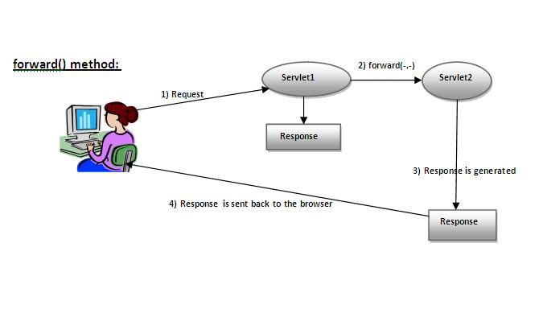
Forword() method
As you see in the above figure, response of second servlet is sent to the client. Response of the first servlet is not displayed to the user.

Slide 33
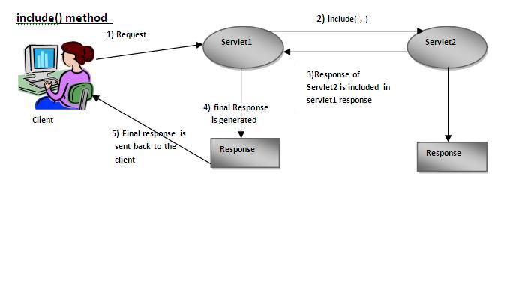
Include() method:
As you can see in the above figure, response of second servlet is included in the response of the first servlet that is being sent to the client.

Slide 34
How to get the object of RequestDispatcher?
The getRequestDispatcher() method of ServletRequest interface returns the object of RequestDispatcher.
Syntax:
public RequestDispatcher getRequestDispatcher(String resource);
Example:
RequestDispatcher rd=request.getRequestDispatcher("servlet2");
//servlet2 is the url-pattern of the second servlet
rd.forward(request, response);//method may be include or forward

Slide 35
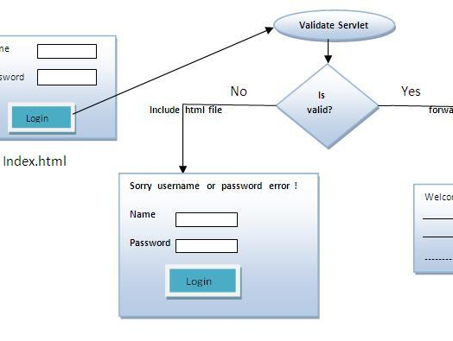
Example of RequestDispatcher interface:

Slide 36
SendRedirect in servlet
The sendRedirect() method of HttpServletResponse interface can be used to redirect response to another resource, it may be servlet, jsp or html file.
It accepts relative as well as absolute URL.
It works at client side because it uses the url bar of the browser to make another request.
So, it can work inside and outside the server.

Slide 37
Difference between forward() and sendRedirect() method
forward() method | sendRedirect() method
The forward() method works at server side. | The sendRedirect() method works at client side.
It sends the same request and response objects to another servlet. | It always sends a new request.
It can work within the server only. | It can be used within and outside the server.
Example: request.getRequestDispacher("servlet2").forward(request,response); | Example: response.sendRedirect("servlet2");

Slide 38

ServletConfig Interface
An object of ServletConfig is created by the web container for each servlet.
This object can be used to get configuration information from web.xml file.
If the configuration information is modified from the web.xml file, we don't need to change the servlet.
So it is easier to manage the web application if any specific content is modified from time to time.
Advantage of ServletConfig
The core advantage of ServletConfig is that you don't need to edit the servlet file if information is modified from the web.xml file.

Slide 39
Methods of ServletConfig interface
Methods | Description
public String getInitParameter(String name) | Returns the parameter value for the specified parameter name.
public Enumeration getInitParameterNames() | Returns an enumeration of all the initialization parameter names.
public String getServletName() | Returns the name of the servlet.
public ServletContext getServletContext() | Returns an object of ServletContext.
How to get the object of ServletConfig?
getServletConfig() method of Servlet interface returns the object of ServletConfig.

Slide 40
Example of getServletConfig() method
ServletConfig config=getServletConfig();
//Now we can call the methods of ServletConfig interface
Syntax to provide the initialization parameter for a servlet
The init-param sub-element of servlet is used to specify the initialization parameter for a servlet.
<web-app>
<servlet>
......
<init-param>
<param-name>parametername</param-name>
<param-value>parametervalue</param-value>
</init-param>
......
</servlet>
</web-app>

Slide 41
ServletContext Interface
An object of ServletContext is created by the web container at time of deploying the project.
This object can be used to get configuration information from web.xml file.
There is only one ServletContext object per web application.
If any information is shared to many servlet, it is better to provide it from the web.xml file using the <context-param> element.
Advantage:
Ease to Maintain

Slide 42
Commonly used methods of ServletContext interface
Method | Description
public String getInitParameter(String name) | Returns the parameter value for the specified parameter name.
public Enumeration getInitParameterNames() | Returns the names of the context's initialization parameters.
public void setAttribute(String name,Object object) | sets the given object in the application scope.
public Object getAttribute(String name) | Returns the attribute for the specified name.
public Enumeration getInitParameterNames() | Returns the names of the context's initialization parameters as an Enumeration of String objects.
public void removeAttribute(String name) | Removes the attribute with the given name from the servlet context.

Slide 43
Attribute in Servlet
An attribute in servlet is an object that can be set, get or removed from one of the following scopes:
request scope
session scope
application scope
The servlet programmer can pass information from one servlet to another using attributes.
It is just like passing object from one class to another so that we can reuse the same object again and again.

Slide 44
4 attribute specific methods
Methods | Description
public void setAttribute(String name,Object object) | sets the given object in the application scope.
public Object getAttribute(String name) | Returns the attribute for the specified name.
public Enumeration getInitParameterNames() | Returns the names of the context's initialization parameters as an Enumeration of String objects.
public void removeAttribute(String name) | Removes the attribute with the given name from the servlet context.

Slide 45
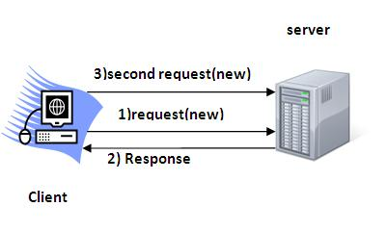
Session Tracking in Servlets
Session simply means a particular interval of time.
Session Tracking is a way to maintain state (data) of an user. It is also known as session management in servlet.
Http protocol is a stateless so we need to maintain state using session tracking techniques.
Each time user requests to the server, server treats the request as the new request.
So we need to maintain the state of an user to recognize to particular user.
HTTP is stateless that means each request is considered as the new request.

Slide 46
Why use Session Tracking?
To recognize the user It is used to recognize the particular user.
Session Tracking Techniques
There are four techniques used in Session tracking:
Cookies
Hidden Form Field
URL Rewriting
HttpSession

Slide 47
Cookies in Servlet
A cookie is a small piece of information that is persisted between the multiple client requests.
A cookie has a name, a single value, and optional attributes such as a comment, path and domain qualifiers, a maximum age, and a version number.

Slide 48
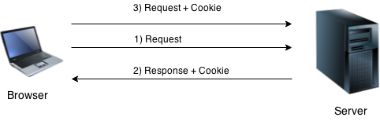
How Cookie works?
By default, each request is considered as a new request.
In cookies technique, we add cookie with response from the servlet.
So cookie is stored in the cache of the browser.
After that if request is sent by the user, cookie is added with request by default.
Thus, we recognize the user as the old user.

Slide 49
Types of Cookie
There are 2 types of cookies in servlets.
Non-persistent cookie
Persistent cookie
Non-persistent cookie
It is valid for single session only. It is removed each time when user closes the browser.
Persistent cookie
It is valid for multiple session . It is not removed each time when user closes the browser. It is removed only if user logout or signout.

Slide 50
Cookies
Advantage of Cookies
Simplest technique of maintaining the state.
Cookies are maintained at client side.
Disadvantage of Cookies
It will not work if cookie is disabled from the browser.
Only textual information can be set in Cookie object.

Slide 51
Cookie class
javax.servlet.http.Cookie class provides the functionality of using cookies. It provides a lot of useful methods for cookies.
Constructor of Cookie class
Constructor | Description
Cookie() | constructs a cookie.
Cookie(String name, String value) | constructs a cookie with a specified name and value.

Slide 52
Useful Methods of Cookie class
Method | Description
public void setMaxAge(int expiry) | Sets the maximum age of the cookie in seconds.
public String getName() | Returns the name of the cookie.
public String getValue() | Returns the value of the cookie.
public void setName(String name) | changes the name of the cookie.
public void setValue(String value) | changes the value of the cookie.
Other methods required for using Cookies
For adding cookie or getting the value from the cookie, we need some methods provided by other interfaces.
They are:
public void addCookie(Cookie ck):method of HttpServletResponse interface is used to add cookie in response object.
public Cookie[] getCookies():method of HttpServletRequest interface is used to return all the cookies from the browser.

Slide 53
How to create Cookie?
How to delete Cookie?
How to get Cookies?
Cookie ck=new Cookie("user",“Hello World");//creating cookie object
response.addCookie(ck);//adding cookie in the response
Cookie ck=new Cookie("user","");//deleting value of cookie
ck.setMaxAge(0);//changing the maximum age to 0 seconds
response.addCookie(ck);//adding cookie in the response
Cookie ck[]=request.getCookies();
for(int i=0;i<ck.length;i++){
out.print("<br>"+ck[i].getName()+" "+ck[i].getValue());//printing name and value of cookie
}

Slide 54
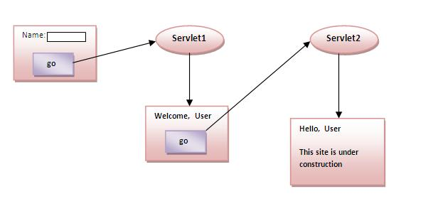
we are storing the name of the user in the cookie object and accessing it in another servlet.
As we know well that session corresponds to the particular user.
So if you access it from too many browsers with different values, you will get the different value.

Slide 55
HIDDEN FIELD-IN HTML
Hidden fields are similar to text fields, with one very important difference!
The difference is that the hidden field does not show on the page.
Therefore the visitor can't type anything into a hidden field, which leads to the purpose of the field:
To submit information that is not entered by the visitor.

Slide 56
<html> <head> <title>My Page</title> </head> <body> <form name="myform" action="http://www.mydomain.com/myformhandler.cgi" method="POST"> <div align="center"> <input type="text" size="25" value="Enter your name here!"> <input type="hidden" name="Language" value="English"> <br><br> </div> </form> </body> </html>
The hidden field does not show, but still, when the form is submitted the hidden field is sent with it.
In this example the hidden field would tell the program that handles the form, that the users preferred language is English

Slide 57
Hidden Form Field
Hidden Form Field a hidden (invisible) textfield is used for maintaining the state of an user.
In such case, we store the information in the hidden field and get it from another servlet.
This approach is better if we have to submit form in all the pages and we don't want to depend on the browser.
code to store value in hidden field.
<input type="hidden" name="uname" value=“Administrator">
Here, uname is the hidden field name and Administrator is the hidden field value.

Slide 58
Real application of hidden form field
It is widely used in comment form of a website.
In such case, we store page id or page name in the hidden field so that each page can be uniquely identified.
Advantage of Hidden Form Field
It will always work whether cookie is disabled or not.
Disadvantage of Hidden Form Field:
It is maintained at server side.
Extra form submission is required on each pages.
Only textual information can be used.

Slide 59
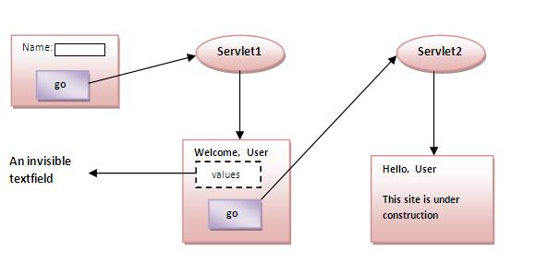

Slide 60
URL Rewriting
In URL rewriting, we append a token or identifier to the URL of the next Servlet or the next resource.
We can send parameter name/value pairs using the following format:
url?name1=value1&name2=value2&??
A name and a value is separated using an equal = sign, a parameter name/value pair is separated from another parameter using the ampersand(&).
When the user clicks the hyperlink, the parameter name/value pairs will be passed to the server.

Slide 61
Advantage of URL Rewriting
It will always work whether cookie is disabled or not (browser independent).
Extra form submission is not required on each pages.
Disadvantage of URL Rewriting
It will work only with links.
It can send Only textual information.

Slide 62
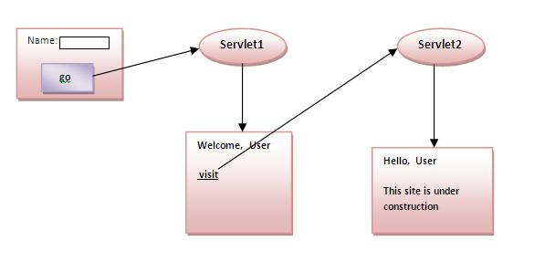

Slide 63
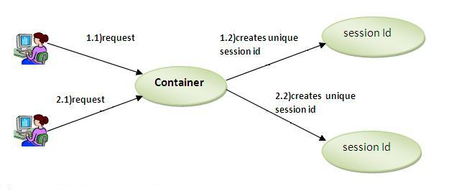
HttpSession interface
container creates a session id for each user.
The container uses this id to identify the particular user.
An object of HttpSession can be used to perform two tasks:
bind objects
view and manipulate information about a session, such as the session identifier, creation time, and last accessed time.

Slide 64
public String getId() | Returns a string containing the unique identifier value.
public long getCreationTime() | Returns the time when this session was created, measured in milliseconds since midnight January 1, 1970 GMT.
public long getLastAccessedTime() | Returns the last time the client sent a request associated with this session, as the number of milliseconds since midnight January 1, 1970 GMT.
public void invalidate() | Invalidates this session then unbinds any objects bound to it.
How to get the HttpSession object ?
public HttpSession getSession():
Returns the current session associated with this request, or if the request does not have a session, creates one.
public HttpSession getSession(boolean create):
Returns the current HttpSession associated with this request or, if there is no current session and create is true, returns a new session.
Commonly used methods of HttpSession interface

Slide 65
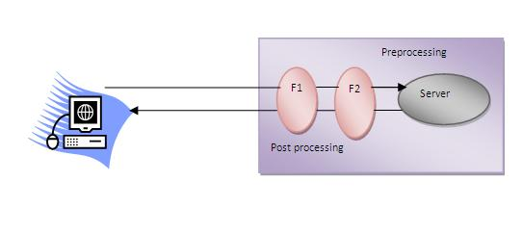
Servlet Filter
A filter is an object that is invoked at the preprocessing and postprocessing of a request.
It is mainly used to perform filtering tasks such as conversion, logging, compression, encryption and decryption, input validation etc.
The servlet filter is pluggable, i.e. its entry is defined in the web.xml file, if we remove the entry of filter from the web.xml file, filter will be removed automatically and we don't need to change the servlet.
So maintenance cost will be less.

Slide 66
Usage of Filter
recording all incoming requests
logs the IP addresses of the computers from which the requests originate
conversion
data compression
encryption and decryption
input validation etc.
Advantage of Filter
Filter is pluggable.
One filter don't have dependency onto another resource.
Less Maintenance

Slide 67

Filter API
Like servlet ,filter have its own API.
The javax.servlet package contains the three interfaces of Filter API.
Filter
FilterChain
FilterConfig

Slide 68
Filter interface
For creating any filter, you must implement the Filter interface.
Filter interface provides the life cycle methods for a filter.
Method | Description
public void init(FilterConfig config) | init() method is invoked only once. It is used to initialize the filter.
public void doFilter(HttpServletRequest request,HttpServletResponse response, FilterChain chain) | doFilter() method is invoked every time when user request to any resource, to which the filter is mapped.It is used to perform filtering tasks.
public void destroy() | This is invoked only once when filter is taken out of the service.

Slide 69
FilterChain interface
The object of FilterChain is responsible to invoke the next filter or resource in the chain.
This object is passed in the doFilter method of Filter interface.
The FilterChain interface contains only one method:
public void doFilter(HttpServletRequest request, HttpServletResponse response)
it passes the control to the next filter or resource.

Slide 70
How to define Filter in web.xml?
<web-app>
<filter>
<filter-name>...</filter-name>
<filter-class>...</filter-class>
</filter>
<filter-mapping>
<filter-name>...</filter-name>
<url-pattern>...</url-pattern>
</filter-mapping>
</web-app>

Slide 71
Authentication Filter
We can perform authentication in filter.
we are going to check to password given by the user in filter class, if given password is admin, it will forward the request to the WelcomeAdmin servlet otherwise it will display error message.

Slide 72
FilterConfig
public void init(FilterConfig config) | init() method is invoked only once it is used to initialize the filter.
public String getInitParameter(String parameterName): | Returns the parameter value for the specified parameter name.
public java.util.Enumeration getInitParameterNames() | Returns an enumeration containing all the parameter names.
public ServletContext getServletContext() | Returns the ServletContext object.
An object of FilterConfig is created by the web container.
This object can be used to get the configuration information from the web.xml file.

Slide 73

Event and Listener in Servlet
Events are basically occurrence of something.
Changing the state of an object is known as an event.
We can perform some important tasks at the occurrence of these exceptions, such as counting total and current logged-in users, creating tables of the database at time of deploying the project, creating database connection object etc.
There are many Event classes and Listener interfaces in the javax.servlet and javax.servlet.http packages.

Slide 74
Event classes
ServletRequestEvent
ServletContextEvent
ServletRequestAttributeEvent
ServletContextAttributeEvent
HttpSessionEvent
HttpSessionBindingEvent

Slide 75
Event interfaces
The event interfaces are as follows:
ServletRequestListener(implemented to notify the request coming in scope and going out of scope for a servlet)
ServletRequestAttributeListener(implemented to notify the changes (addition,replacement or removal) in the request attributes)
ServletContextListener(implemented to notify the initialization or destruction of the servlet )
ServletContextAttributeListener(implemented to notify the changes (addition,replacement or removal) in the context attributes)

Slide 76

HttpSessionListener(implemented to notify the initialization or destruction of the Http Session.)
HttpSessionAttributeListener(implemented to notify when a sessions object migrates from one VM to another.)
HttpSessionBindingListener(has the relevance when a session is part of a web application in a distributed environment.)
HttpSessionActivationListener(implemented to notify the changes in the HttpSession attribute.)

Slide 77
Any Question?

Slide 78
JSP

Slide 79
JSP technology is used to create web application just like Servlet technology.
It can be thought of as an extension to servlet because it provides more functionality than servlet such as expression language, jstl etc.
A JSP page consists of HTML tags and JSP tags.
The jsp pages are easier to maintain than servlet because we can separate designing and development.
It provides some additional features such as Expression Language, Custom Tag etc.

Slide 80

Advantage of JSP over Servlet
Extension to Servlet
JSP technology is the extension to servlet technology.
We can use all the features of servlet in JSP.
In addition to, we can use implicit objects, predefined tags, expression language and Custom tags in JSP, that makes JSP development easy.
2) Easy to maintain
JSP can be easily managed because we can easily separate our business logic with presentation logic.
In servlet technology, we mix our business logic with the presentation logic.

Slide 81

Fast Development: No need to recompile and redeploy
If JSP page is modified, we don't need to recompile and redeploy the project.
The servlet code needs to be updated and recompiled if we have to change the look and feel of the application.
4) Less code than Servlet
In JSP, we can use a lot of tags such as action tags, jstl, custom tags etc. that reduces the code.

Slide 82
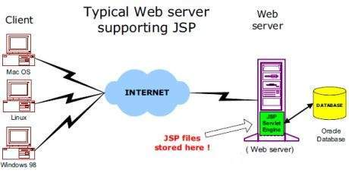
The web server needs a JSP engine ie. container to process JSP pages.
The JSP container is responsible for intercepting requests for JSP pages.
A JSP container works with the Web server to provide the runtime environment and other services a JSP needs.

Slide 83
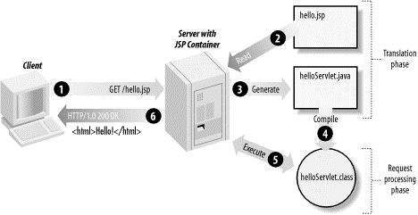
JSP Processing:

Slide 84
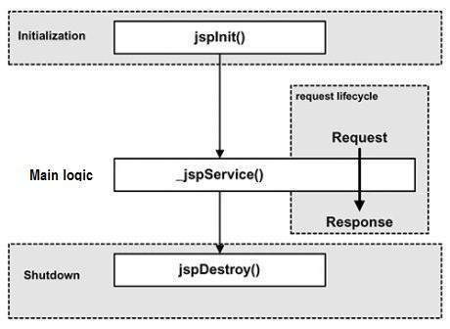
JSP - Life Cycle
Compilation
Initialization
Execution
Cleanup

Slide 85

JSP Compilation:
When a browser asks for a JSP, the JSP engine first checks to see whether it needs to compile the page.
If the page has never been compiled, or if the JSP has been modified since it was last compiled, the JSP engine compiles the page.
The compilation process involves three steps:
Parsing the JSP.
Turning the JSP into a servlet.
Compiling the servlet.

Slide 86
JSP Initialization:
When a container loads a JSP it invokes the jspInit() method before servicing any requests.
If you need to perform JSP-specific initialization, override the jspInit() method:
Syntax
public void jspInit(){ // Initialization code... }
Typically initialization is performed only once and as with the servlet init method, you generally initialize database connections, open files, and create lookup tables in the jspInit method.

Slide 87
JSP Execution:
This phase of the JSP life cycle represents all interactions with requests until the JSP is destroyed.
Whenever a browser requests a JSP and the page has been loaded and initialized, the JSP engine invokes the _jspService() method in the JSP.
The _jspService() method takes an HttpServletRequest and an HttpServletResponse as its parameters as follows:
Syntax:
void _jspService(HttpServletRequest request, HttpServletResponse response) { // Service handling code... }
The _jspService() method of a JSP is invoked once per a request .
And responsible for generating the response for that request and this method is also responsible for generating responses to all seven of the HTTP methods ie. GET, POST, DELETE etc.

Slide 88
JSP Cleanup:
The destruction phase of the JSP life cycle represents when a JSP is being removed from use by a container.
The jspDestroy() method is the JSP equivalent of the destroy method for servlets.
The jspDestroy() method is the JSP equivalent of the destroy method for servlets.
Syntax
public void jspDestroy() { // Your cleanup code goes here. }

Slide 89
JSP directives
The jsp directives are messages that tells the web container how to translate a JSP page into the corresponding servlet.
There are three types of directives:
page directive
include directive
taglib directive
Syntax of JSP Directives
<%@ directive attribute="value" %>

Slide 90
JSP page directive
The page directive defines attributes that apply to an entire JSP page.
Syntax of JSP page directive
<%@ page attribute="value" %>

Slide 91
Attributes of JSP page directive
import
contentType (response.setContentType(“text/html”)
extends
Info (web.xml → datafetch→ServletContext, ServletConfig)
Buffer ( memory Allocation)
Language ( java)
isELIgnored (${} → true , false )
isThreadSafe
autoFlush ( JDBC –Connection close)
Session
pageEncoding (UTF-8)
errorPage (Exception)
isErrorPage(Boolean → Ture , false)

Slide 92
Import (<%@ page import="java.util.Date" %> )
The import attribute is used to import class,interface or all the members of a package.It is similar to import keyword in java class or interface.
contentType (<%@ page contentType="text/html" %>)
The contentType attribute defines the MIME(Multipurpose Internet Mail Extension) type of the HTTP response.
The default value is "text/html;charset=ISO-8859-1“
Extends (<%@ page extends="package.class" %>)
The extends attribute defines the parent class that will be inherited by the generated servlet.It is rarely used.
Info(<%@ page info="myPageInfo" %>)
This attribute simply sets the information of the JSP page which is retrieved later by using getServletInfo() method of Servlet interface.

Slide 93

Buffer (<%@ page buffer="16kb" %>)
The buffer attribute sets the buffer size in kilobytes to handle output generated by the JSP page.
The default size of the buffer is 8Kb
Language (<%@ page language="java" %>)
The language attribute specifies the scripting language used in the JSP page.
The default value is "java".
isELIgnored (<%@ page isELIgnored="true" %>//Now EL will be ignored )
We can ignore the Expression Language (EL) in jsp by the isELIgnored attribute.
By default its value is false i.e. Expression Language is enabled by default.
We see Expression Language later.

Slide 94
isThreadSafe (<%@ page isThreadSafe="false" %>)
Servlet and JSP both are multithreaded.
If you want to control this behaviour of JSP page, you can use isThreadSafe attribute of page directive.
The value of isThreadSafe value is true.
If you make it false, the web container will serialize the multiple requests, i.e. it will wait until the JSP finishes responding to a request before passing another request to it.
errorPage(<%@ page errorPage="myerrorpage.jsp" %> )
The errorPage attribute is used to define the error page, if exception occurs in the current page, it will be redirected to the error page.
isErrorPage (<%@ page isErrorPage="true" %> )
The isErrorPage attribute is used to declare that the current page is the error page.

Slide 95
autoFlush Attribute (<%@ page autoFlush="true" %>)
The autoFlush attribute tells the JSP container whether the buffered output should be flushed.
When it is set to "true", the container automatically sends the contents of the buffer to the output stream when the buffer becomes full.
Session(<%@ page session="true" %>)
The session attribute of the Page Directive indicates whether the page is part of a session.

Slide 96
Jsp Include Directive
The include directive is used to include the contents of any resource it may be jsp file, html file or text file.
The include directive includes the original content of the included resource at page translation time.
Advantage of Include directive
Code Reusability
Syntax of include directive
<%@ include file="resourceName" %>

Slide 97

JSP Taglib directive
The JSP taglib directive is used to define a tag library that defines many tags.
We use the TLD (Tag Library Descriptor) file to define the tags.
In the custom tag section we will use this tag so it will be better to learn it in custom tag.
Syntax JSP Taglib directive
<%@ taglib uri="uriofthetaglibrary" prefix="prefixoftaglibrary" %>

Slide 98
JSP Action Tags
There are many JSP action tags or elements.
Each JSP action tag is used to perform some specific tasks.
The action tags are used to control the flow between pages and to use Java Bean.

Slide 99
JSP Action Tags | Description
jsp:forward | forwards the request and response to another resource.
jsp:include | includes another resource.
jsp:useBean | creates or locates bean object.
jsp:setProperty | sets the value of property in bean object.
jsp:getProperty | prints the value of property of the bean.
jsp:plugin | embeds another components such as applet.
jsp:param | sets the parameter value. It is used in forward and include mostly.
jsp:fallback | can be used to print the message if plugin is working. It is used in jsp:plu

Slide 100
jsp:forward
The jsp:forward action tag is used to forward the request to another resource it may be jsp, html or another resource.
Syntax without Parameter
<jsp:forward page="relativeURL | <%= expression %>" />
Syntax with Parameter
<jsp:forward page="relativeURL | <%= expression %>">
<jsp:param name="parametername" value="parametervalue | <%=expression%>" />
</jsp:forward>

Slide 101

jsp:include
The jsp:include action tag is used to include the content of another resource it may be jsp, html or servlet.
The jsp include action tag includes the resource at request time so it is better for dynamic pages because there might be changes in future.
The jsp:include tag can be used to include static as well as dynamic pages.
Advantage
Code reusability : We can use a page many times such as including header and footer pages in all pages. So it saves a lot of time.

Slide 102
Difference
JSP include directive | JSP include action
includes resource at translation time. | includes resource at request time.
better for static pages. | better for dynamic pages.
includes the original content in the generated servlet. | calls the include method.
Syntax of jsp:include action tag without parameter
<jsp:include page="relativeURL | <%= expression %>" />
Syntax of jsp:include action tag with parameter
<jsp:include page="relativeURL | <%= expression %>">
<jsp:param name="parametername" value="parametervalue | <%=expression%>" />
</jsp:include>

Slide 103
Java Bean{similar like Package}
A Java Bean is a java class that should follow following conventions:
It should have a no-arg constructor.
It should be Serializable.
It should provide methods to set and get the values of the properties, known as getter and setter methods.
Why use Java Bean?
it is a reusable software component.
A bean encapsulates many objects into one object, so we can access this object from multiple places.

Slide 104

jsp:useBean
The jsp:useBean action tag is used to locate or instantiate a bean class.
If bean object of the Bean class is already created, it doesn't create the bean depending on the scope.
But if object of bean is not created, it instantiates the bean.

Slide 105
Syntax of jsp:useBean action tag
<jsp:useBean id= "instanceName" scope= "page | request | session | application"
class= "packageName.className" type= "packageName.className"
beanName="packageName.className | <%= expression >" >
</jsp:useBean>
Attributes and Usage of jsp:useBean action tag
id: is used to identify the bean in the specified scope.
scope: represents the scope of the bean. It may be page, request, session or application. The default scope is page.
page: specifies that you can use this bean within the JSP page. The default scope is page.
request: specifies that you can use this bean from any JSP page that processes the same request. It has wider scope than page.
session: specifies that you can use this bean from any JSP page in the same session whether processes the same request or not. It has wider scope than request.
application: specifies that you can use this bean from any JSP page in the same application. It has wider scope than session.

Slide 106
class: instance the specified bean class (i.e. creates an object of the bean class) but it must have no-arg or no constructor and must not be abstract.
type: provides the bean a data type if the bean already exists in the scope. It is mainly used with class or beanName attribute. If you use it without class or beanName, no bean is instantiated.
beanName: instantiates the bean using the java.beans.Beans.instantiate() method.

Slide 107
jsp:setProperty and jsp:getProperty
The setProperty and getProperty action tags are used for developing web application with Java Bean.
In web devlopment, bean class is mostly used because it is a reusable software component that represents data.
The jsp:setProperty action tag sets a property value or values in a bean using the setter method.
Syntax of jsp:setProperty action tag
<jsp:setProperty name="instanceOfBean" property= "*" |
property="propertyName" param="parameterName" |
property="propertyName" value="{ string | <%= expression %>}" />

Slide 108
jsp:setProperty action tag if you have to set all the values of incoming request in the bean
<jsp:setProperty name="bean" property="*" />
jsp:setProperty action tag if you have to set value of the incoming specific property
<jsp:setProperty name="bean" property="username" />
jsp:setProperty action tag if you have to set a specific value in the property
<jsp:setProperty name="bean" property="username" value="Kumar" />
jsp:getProperty action tag
The jsp:getProperty action tag returns the value of the property.
Syntax of jsp:getProperty action tag
<jsp:getProperty name="instanceOfBean" property="propertyName" />
Simple example of jsp:getProperty action tag
<jsp:getProperty name="obj" property="name" />

Slide 109

JSP Scriptlet tag
Java code can be written inside the jsp page using the scriptlet tag.
JSP Scripting elements
The scripting elements provides the ability to insert java code inside the jsp.
There are three types of scripting elements:
scriptlet tag
expression tag
declaration tag
Syntax:-
<% java source code %>

Slide 110
JSP expression tag
The code placed within JSP expression tag is written to the output stream of the response.
So you need not write out.print() to write data.
It is mainly used to print the values of variable or method.
Syntax:
<%= statement %>

Slide 111
JSP Declaration Tag
The JSP declaration tag is used to declare fields and methods.
The code written inside the jsp declaration tag is placed outside the service() method of auto generated servlet.
So it doesn't get memory at each request.
Syntax:
<%! field or method declaration %>
Jsp Scriptlet Tag | Jsp Declaration Tag
The jsp scriptlet tag can only declare variables not methods. | The jsp declaration tag can declare variables as well as methods.
The declaration of scriptlet tag is placed inside the _jspService() method. | The declaration of jsp declaration tag is placed outside the _jspService() method.

Slide 112
JSP Implicit Objects
Object | Type
out | JspWriter
request | HttpServletRequest
response | HttpServletResponse
config | ServletConfig
application | ServletContext
session | HttpSession
pageContext | PageContext
page | Object
exception | Throwable
There are 9 jsp implicit objects.
These objects are created by the web container that are available to all the jsp pages.

Slide 113

JSP out implicit object
For writing any data to the buffer, JSP provides an implicit object named out.
It is the object of JspWriter.
In case of servlet you need to write:
PrintWriter out=response.getWriter();
But in JSP, you don't need to write this code.
<% out.print("Today is:"+java.util.Calendar.getInstance().getTime()); %>

Slide 114
JSP request implicit object
The JSP request is an implicit object of type HttpServletRequest.
created for each jsp request by the web container.
It can be used to get request information such as parameter, header information, remote address, server name, server port, content type, character encoding etc.
It can also be used to set, get and remove attributes from the jsp request scope.

Slide 115

Example of Request
index.html
<form action="welcome.jsp">
<input type="text" name="uname">
<input type="submit" value="go"><br/>
</form>
welcome.jsp
<%
String name=request.getParameter("uname");
out.print("welcome "+name);
%>

Slide 116
JSP response implicit object
In JSP, response is an implicit object of type HttpServletResponse.
The instance of HttpServletResponse is created by the web container for each jsp request.
It can be used to add or manipulate response such as redirect response to another resource, send error etc.

Slide 117
JSP config implicit object
In JSP, config is an implicit object of type ServletConfig.
This object can be used to get initialization parameter for a particular JSP page.
The config object is created by the web container for each jsp page.

Slide 118
JSP application implicit object
In JSP, application is an implicit object of type ServletContext.
The instance of ServletContext is created only once by the web container when application or project is deployed on the server.
This object can be used to get initialization parameter from configuaration file (web.xml). It can also be used to get, set or remove attribute from the application scope.
This initialization parameter can be used by all jsp pages.

Slide 119
session implicit object
In JSP, session is an implicit object of type HttpSession.
The Java developer can use this object to set, get or remove attribute or to get session information.

Slide 120
pageContext implicit object
In JSP, pageContext is an implicit object of type PageContext class.
The pageContext object can be used to set,get or remove attribute from one of the following scopes:
page
request
session
application

Slide 121
page implicit object:
Page implicit object is a reference to the current Servlet instance.
We can simply use this in place of it.
This object is assigned to the reference of auto generated servlet class.
Example:-
<% this.log("message"); %>

Slide 122
Exception implicit object
Exception is an implicit object of type java.lang.Throwable class.
This object can be used to print the exception.
But it can only be used in error pages.
It is better to learn it after page directive.

Slide 123
Exception Handling in JSP
The exception is normally an object that is thrown at runtime.
Exception Handling is the process to handle the runtime errors.
There may occur exception any time in your web application.
So handling exceptions is a safer side for the web developer.
In JSP, there are two ways to perform exception handling:
By errorPage and isErrorPage attributes of page directive
By <error-page> element in web.xml file

Slide 124
Custom Tags in JSP
Custom tags are user-defined tags.
They eliminates the possibility of scriptlet tag and separates the business logic from the JSP page.
The same business logic can be used many times by the use of custom tag.
Advantages of Custom Tags
Eliminates the need of scriptlet tag The custom tags eliminates the need of scriptlet tag which is considered bad programming approach in JSP.
Separation of business logic from JSP The custom tags separate the the business logic from the JSP page so that it may be easy to maintain.
Re-usability The custom tags makes the possibility to reuse the same business logic again and again.

Slide 125
Syntax to use custom tag
One way
<prefix:tagname attr1=value1....attrn=valuen />
Second way
<prefix:tagname attr1=value1....attrn=valuen >
body code
</prefix:tagname>

Slide 126
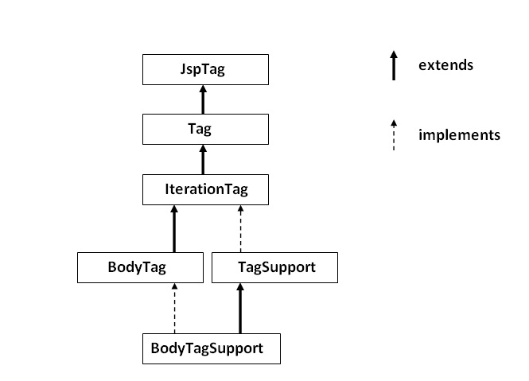
JSP Custom Tag API
The javax.servlet.jsp.tagext package contains classes and interfaces for JSP custom tag API.
The JspTag is the root interface
in the Custom Tag hierarchy.

Slide 127
Example of JSP Custom Tag
we are going to create a custom tag that prints the current date and time.
We are performing action at the start of tag.
For creating any custom tag, we need to follow following steps:
Create the Tag handler class and perform action at the start or at the end of the tag.
Create the Tag Library Descriptor (TLD) file and define tags
Create the JSP file that uses the Custom tag defined in the TLD file

Slide 128
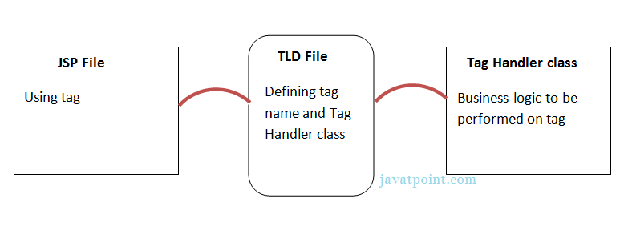
Understanding flow of custom tag in jsp

Slide 129
JspTag interface
The JspTag is the root interface for all the interfaces and classes used in custom tag. It is a marker interface.
Tag interface
The Tag interface is the sub interface of JspTag interface. It provides methods to perform action at the start and end of the tag.
Fields of Tag interface
Field Name | Description
public static int EVAL_BODY_INCLUDE | it evaluates the body content.
public static int EVAL_PAGE | it evaluates the JSP page content after the custom tag.
public static int SKIP_BODY | it skips the body content of the tag.
public static int SKIP_PAGE | it skips the JSP page content after the custom tag.

Slide 130
Method Name | Description
public void setPageContext(PageContext pc) | it sets the given PageContext object.
public void setParent(Tag t) | it sets the parent of the tag handler.
public Tag getParent() | it returns the parent tag handler object.
public int doStartTag()throws JspException | it is invoked by the JSP page implementation object. The JSP programmer should override this method and define the business logic to be performed at the start of the tag.
public int doEndTag()throws JspException | it is invoked by the JSP page implementation object. The JSP programmer should override this method and define the business logic to be performed at the end of the tag.
public void release() | it is invoked by the JSP page implementation object to release the state.
Methods of Tag interface

Slide 131
IterationTag interface
The IterationTag interface is the sub interface of the Tag interface.
It provides an additional method to reevaluate the body.
Field of IterationTag interface
public static int EVAL_BODY_AGAIN it reevaluates the body content.
Method of Tag interface
public int doAfterBody()throws JspException it is invoked by the JSP page implementation object after the evaluation of the body. If this method returns EVAL_BODY_INCLUDE, body content will be reevaluated, if it returns SKIP_BODY, no more body cotent will be evaluated.

Slide 132
TagSupport class
The TagSupport class implements the IterationTag interface.
It acts as the base class for new Tag Handlers.
It provides some additional methods also.

Slide 133
Expression Language (EL) in JSP
The Expression Language (EL) simplifies the accessibility of data stored in the Java Bean component, and other objects like request, session, application etc.
JSP EL allows you to create expressions both (a) arithmetic and (b) logical.
There are many implicit objects, operators and reserve words in EL.
It is the newly added feature in JSP technology version 2.0.
Syntax : -
${ expression }
Example
<jsp:setProperty name="box" property="perimeter" value="${2*box.width+2*box.height}"/>

Slide 134
Implicit Objects in Expression Language (EL)
Implicit Objects | Usage
pageScope | it maps the given attribute name with the value set in the page scope
requestScope | it maps the given attribute name with the value set in the request scope
sessionScope | it maps the given attribute name with the value set in the session scope
applicationScope | it maps the given attribute name with the value set in the application scope
param | it maps the request parameter to the single value
paramValues | it maps the request parameter to an array of values
header | it maps the request header name to the single value
headerValues | it maps the request header name to an array of values
cookie | it maps the given cookie name to the cookie value
initParam | it maps the initialization parameter
pageContext | it provides access to many objects request, session etc.

Slide 135
Basic Operators in EL:
Operator | Description
. | Access a bean property or Map entry
[] | Access an array or List element
( ) | Group a subexpression to change the evaluation order
+ | Addition
- | Subtraction or negation of a value
* | Multiplication
/ or div | Division
% or mod | Modulo (remainder)
== or eq | Test for equality
!= or ne | Test for inequality
< or lt | Test for less than
> or gt | Test for greater than
<= or le | Test for less than or equal
>= or ge | Test for greater than or equal
&& or and | Test for logical AND
|| or or | Test for logical OR
! or not | Unary Boolean complement
empty | Test for empty variable values
JSP Expression Language (EL) supports most of the arithmetic and logical operators supported by Java.

Slide 136
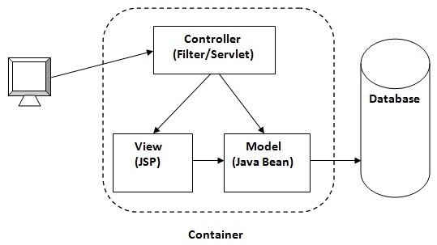
MVC in JSP
MVC stands for Model View and Controller.
It is a design pattern that separates the
business logic, presentation logic and data.
Controller acts as an interface between View and Model. Controller intercepts all the incoming requests.
Model represents the state of the application i.e. data. It can also have business logic.
View represents the presentation i.e. UI(User Interface).
Advantage of MVC (Model 2) Architecture
Navigation Control is centralized
Easy to maintain the large application

Slide 137
MVC Example in JSP
we are using servlet as a controller, jsp as a view component, Java Bean class as a model.
we have created 5 pages:
index.jsp a page that gets input from the user.
ControllerServlet.java a servlet that acts as a controller.
login-success.jsp and login-error.jsp files acts as view components.
web.xml file for mapping the servlet.

Slide 138
JSP-Session Tracking
HTTP is a "stateless" protocol which means each time a client retrieves a Web page, the client opens a separate connection to the Web server and the server automatically does not keep any record of previous client request.
Three ways to maintain the session
Cookies
Hidden Form Field
URL Rewriting

Slide 139
S.N. | Method & Description (FOR SESSION)
1 | public Object getAttribute(String name) This method returns the object bound with the specified name in this session, or null if no object is bound under the name.
2 | public Enumeration getAttributeNames() This method returns an Enumeration of String objects containing the names of all the objects bound to this session.
3 | public long getCreationTime() This method returns the time when this session was created, measured in milliseconds since midnight January 1, 1970 GMT.
4 | public String getId() This method returns a string containing the unique identifier assigned to this session.
5 | public long getLastAccessedTime() This method returns the last time the client sent a request associated with this session, as the number of milliseconds since midnight January 1, 1970 GMT.
6 | public int getMaxInactiveInterval() This method returns the maximum time interval, in seconds, that the servlet container will keep this session open between client accesses.
7 | public void invalidate() This method invalidates this session and unbinds any objects bound to it.
8 | public boolean isNew( This method returns true if the client does not yet know about the session or if the client chooses not to join the session.
9 | public void removeAttribute(String name) This method removes the object bound with the specified name from this session.
10 | public void setAttribute(String name, Object value) This method binds an object to this session, using the name specified.
11 | public void setMaxInactiveInterval(int interval) This method specifies the time, in seconds, between client requests before the servlet container will invalidate this session.

Slide 140
S.N. | Method & Description (COOKIES)
1 | public void setDomain(String pattern) This method sets the domain to which cookie applies, for example tutorialspoint.com.
2 | public String getDomain() This method gets the domain to which cookie applies, for example tutorialspoint.com.
3 | public void setMaxAge(int expiry) This method sets how much time (in seconds) should elapse before the cookie expires. If you don't set this, the cookie will last only for the current session.
4 | public int getMaxAge() This method returns the maximum age of the cookie, specified in seconds, By default, -1 indicating the cookie will persist until browser shutdown.
5 | public String getName() This method returns the name of the cookie. The name cannot be changed after creation.
6 | public void setValue(String newValue) This method sets the value associated with the cookie.
7 | public String getValue() This method gets the value associated with the cookie.
8 | public void setPath(String uri) This method sets the path to which this cookie applies. If you don't specify a path, the cookie is returned for all URLs in the same directory as the current page as well as all subdirectories.
9 | public String getPath() This method gets the path to which this cookie applies.
10 | public void setSecure(boolean flag) This method sets the boolean value indicating whether the cookie should only be sent over encrypted (i.e. SSL) connections.
11 | public void setComment(String purpose) This method specifies a comment that describes a cookie's purpose. The comment is useful if the browser presents the cookie to the user.
12 | public String getComment() This method returns the comment describing the purpose of this cookie, or null if the cookie has no comment.

Slide 141
JSTL (JSP Standard Tag Library)
The JSP Standard Tag Library (JSTL) represents a set of tags to simplify the JSP development.
Advantage of JSTL
Fast Development JSTL provides many tags that simplifies the JSP.
Code Reusability We can use the JSTL tags in various pages.
No need to use scriptlet tag It avoids the use of scriptlet tag.

Slide 142
JSTL Tags
Tag Name | Description
Core tags | The JSTL core tag provide variable support, URL management, flow control etc. The url for the core tag is http://java.sun.com/jsp/jstl/core . The prefix of core tag is c.
Function tags | The functions tags provide support for string manipulation and string length. The url for the functions tags is http://java.sun.com/jsp/jstl/functions and prefix is fn.
Formatting tags | The Formatting tags provide support for message formatting, number and date formatting etc. The url for the Formatting tags is http://java.sun.com/jsp/jstl/fmt and prefix is fmt.
XML tags | The xml sql tags provide flow control, transformation etc. The url for the xml tags is http://java.sun.com/jsp/jstl/xml and prefix is x.
SQL tags | The JSTL sql tags provide SQL support. The url for the sql tags is http://java.sun.com/jsp/jstl/sql and prefix is sql.
There JSTL mainly provides 5 types of tags:

Slide 143
JSTL Core Tags
The JSTL core tag provides variable support, URL management, flow control etc.
The syntax used for including JSTL core library in your JSP is:
<%@ taglib uri="http://java.sun.com/jsp/jstl/core" prefix="c" %>

Slide 144
JSTL Core Tags List
Tags | Description
c:out | It display the result of an expression, similar to the way <%=...%> tag work.
c:import | It Retrives relative or an absolute URL and display the contents to either a String in 'var',a Reader in 'varReader' or the page.
c:set | It sets the result of an expression under evaluation in a 'scope' variable.
c:remove | It is used for removing the specified scoped variable from a particular scope.
c:catch | It is used for Catches any Throwable exceptions that occurs in the body.
c:if | It is conditional tag used for testing the condition and display the body content only if the expression evaluates is true.
c:choose, c:when, c:otherwise | It is the simple conditional tag that includes its body content if the evaluated condition is true.
c:forEach | It is the basic iteration tag. It repeats the nested body content for fixed number of times or over collection.
c:forTokens | It iterates over tokens which is separated by the supplied delimeters.
c:param | It adds a parameter in a containing 'import' tag's URL.
c:redirect | It redirects the browser to a new URL and supports the context-relative URLs.
c:url | It creates a URL with optional query parameters.

Slide 145
JSTL Function Tags
The JSTL function provides a number of standard functions, most of these functions are common string manipulation functions.
The syntax used for including JSTL function library in your JSP is:
<%@ taglib uri="http://java.sun.com/jsp/jstl/functions" prefix="fn" %>

Slide 146
JSTL Function Tag
JSTL Functions | Description
fn:contains() | It is used to test if an input string containing the specified substring in a program.
fn:containsIgnoreCase() | It is used to test if an input string contains the specified substring as a case insensitive way.
fn:endsWith() | It is used to test if an input string ends with the specified suffix.
fn:escapeXml() | It escapes the characters that would be interpreted as XML markup.
fn:indexOf() | It returns an index within a string of first occurrence of a specified substring.
fn:trim() | It removes the blank spaces from both the ends of a string.
fn:startsWith() | It is used for checking whether the given string is started with a particular string value.
fn:split() | It splits the string into an array of substrings.
fn:toLowerCase() | It converts all the characters of a string to lower case.
fn:toUpperCase() | It converts all the characters of a string to upper case.
fn:substring() | It returns the subset of a string according to the given start and end position.
fn:substringAfter() | It returns the subset of string after a specific substring.
fn:substringBefore() | It returns the subset of string before a specific substring.
fn:length() | It returns the number of characters inside a string, or the number of items in a collection.
fn:replace() | It replaces all the occurrence of a string with another string sequence.

Slide 147
JSTL Formatting tags
The formatting tags provide support for message formatting, number and date formatting etc.
http://java.sun.com/jsp/jstl/fmt and prefix is fmt.
The JSTL formatting tags are used for internationalized web sites to display and format text, the time, the date and numbers.
<%@ taglib uri="http://java.sun.com/jsp/jstl/fmt" prefix="fmt" %>

Slide 148
Formatting Tags | Descriptions
fmt:parseNumber | It is used to Parses the string representation of a currency, percentage or number.
fmt:timeZone | It specifies a parsing action nested in its body or the time zone for any time formatting.
fmt:formatNumber | It is used to format the numerical value with specific format or precision.
fmt:parseDate | It parses the string representation of a time and date.
fmt:bundle | It is used for creating the ResourceBundle objects which will be used by their tag body.
fmt:setTimeZone | It stores the time zone inside a time zone configuration variable.
fmt:setBundle | It loads the resource bundle and stores it in a bundle configuration variable or the named scoped variable.
fmt:message | It display an internationalized message.
fmt:formatDate | It formats the time and/or date using the supplied pattern and styles.

Slide 149
JSTL XML tags
The JSTL XML tags are used for providing a JSP-centric way of manipulating and creating XML documents.
The xml tags provide flow control, transformation etc.
The url for the xml tags is http://java.sun.com/jsp/jstl/xml and prefix is x.
The JSTL XML tag library has custom tags used for interacting with XML data.
<%@ taglib uri="http://java.sun.com/jsp/jstl/xml" prefix="x" %>

Slide 150
XML Tags | Descriptions
x:out | Similar to <%= ... > tag, but for XPath expressions.
x:parse | It is used for parse the XML data specified either in the tag body or an attribute.
x:set | It is used to sets a variable to the value of an XPath expression.
x:choose | It is a conditional tag that establish a context for mutually exclusive conditional operations.
x:when | It is a subtag of that will include its body if the condition evaluated be 'true'.
x:otherwise | It is subtag of that follows tags and runs only if all the prior conditions evaluated be 'false'.
x:if | It is used for evaluating the test XPath expression and if it is true, it will processes its body content.
x:transform | It is used in a XML document for providing the XSL(Extensible Stylesheet Language) transformation.
x:param | It is used along with the transform tag for setting the parameter in the XSLT style sheet.

Slide 151
JSTL SQL Tags
The JSTL sql tags provide SQL support.
The url for the sql tags is http://java.sun.com/jsp/jstl/sql and prefix is sql.
The SQL tag library allows the tag to interact with RDBMSs (Relational Databases) such as Microsoft SQL Server, mySQL, or Oracle.
<%@ taglib uri="http://java.sun.com/jsp/jstl/sql" prefix="sql" %>

Slide 152
SQL Tags | Descriptions
sql:setDataSource | It is used for creating a simple data source suitable only for prototyping.
sql:query | It is used for executing the SQL query defined in its sql attribute or the body.
sql:update | It is used for executing the SQL update defined in its sql attribute or in the tag body.
sql:param | It is used for sets the parameter in an SQL statement to the specified value.
sql:dateParam | It is used for sets the parameter in an SQL statement to a specified java.util.Date value.
sql:transaction | It is used to provide the nested database action with a common connection.

Slide 153
Any Questions?

Slide 154
Thank You

